Slide 1
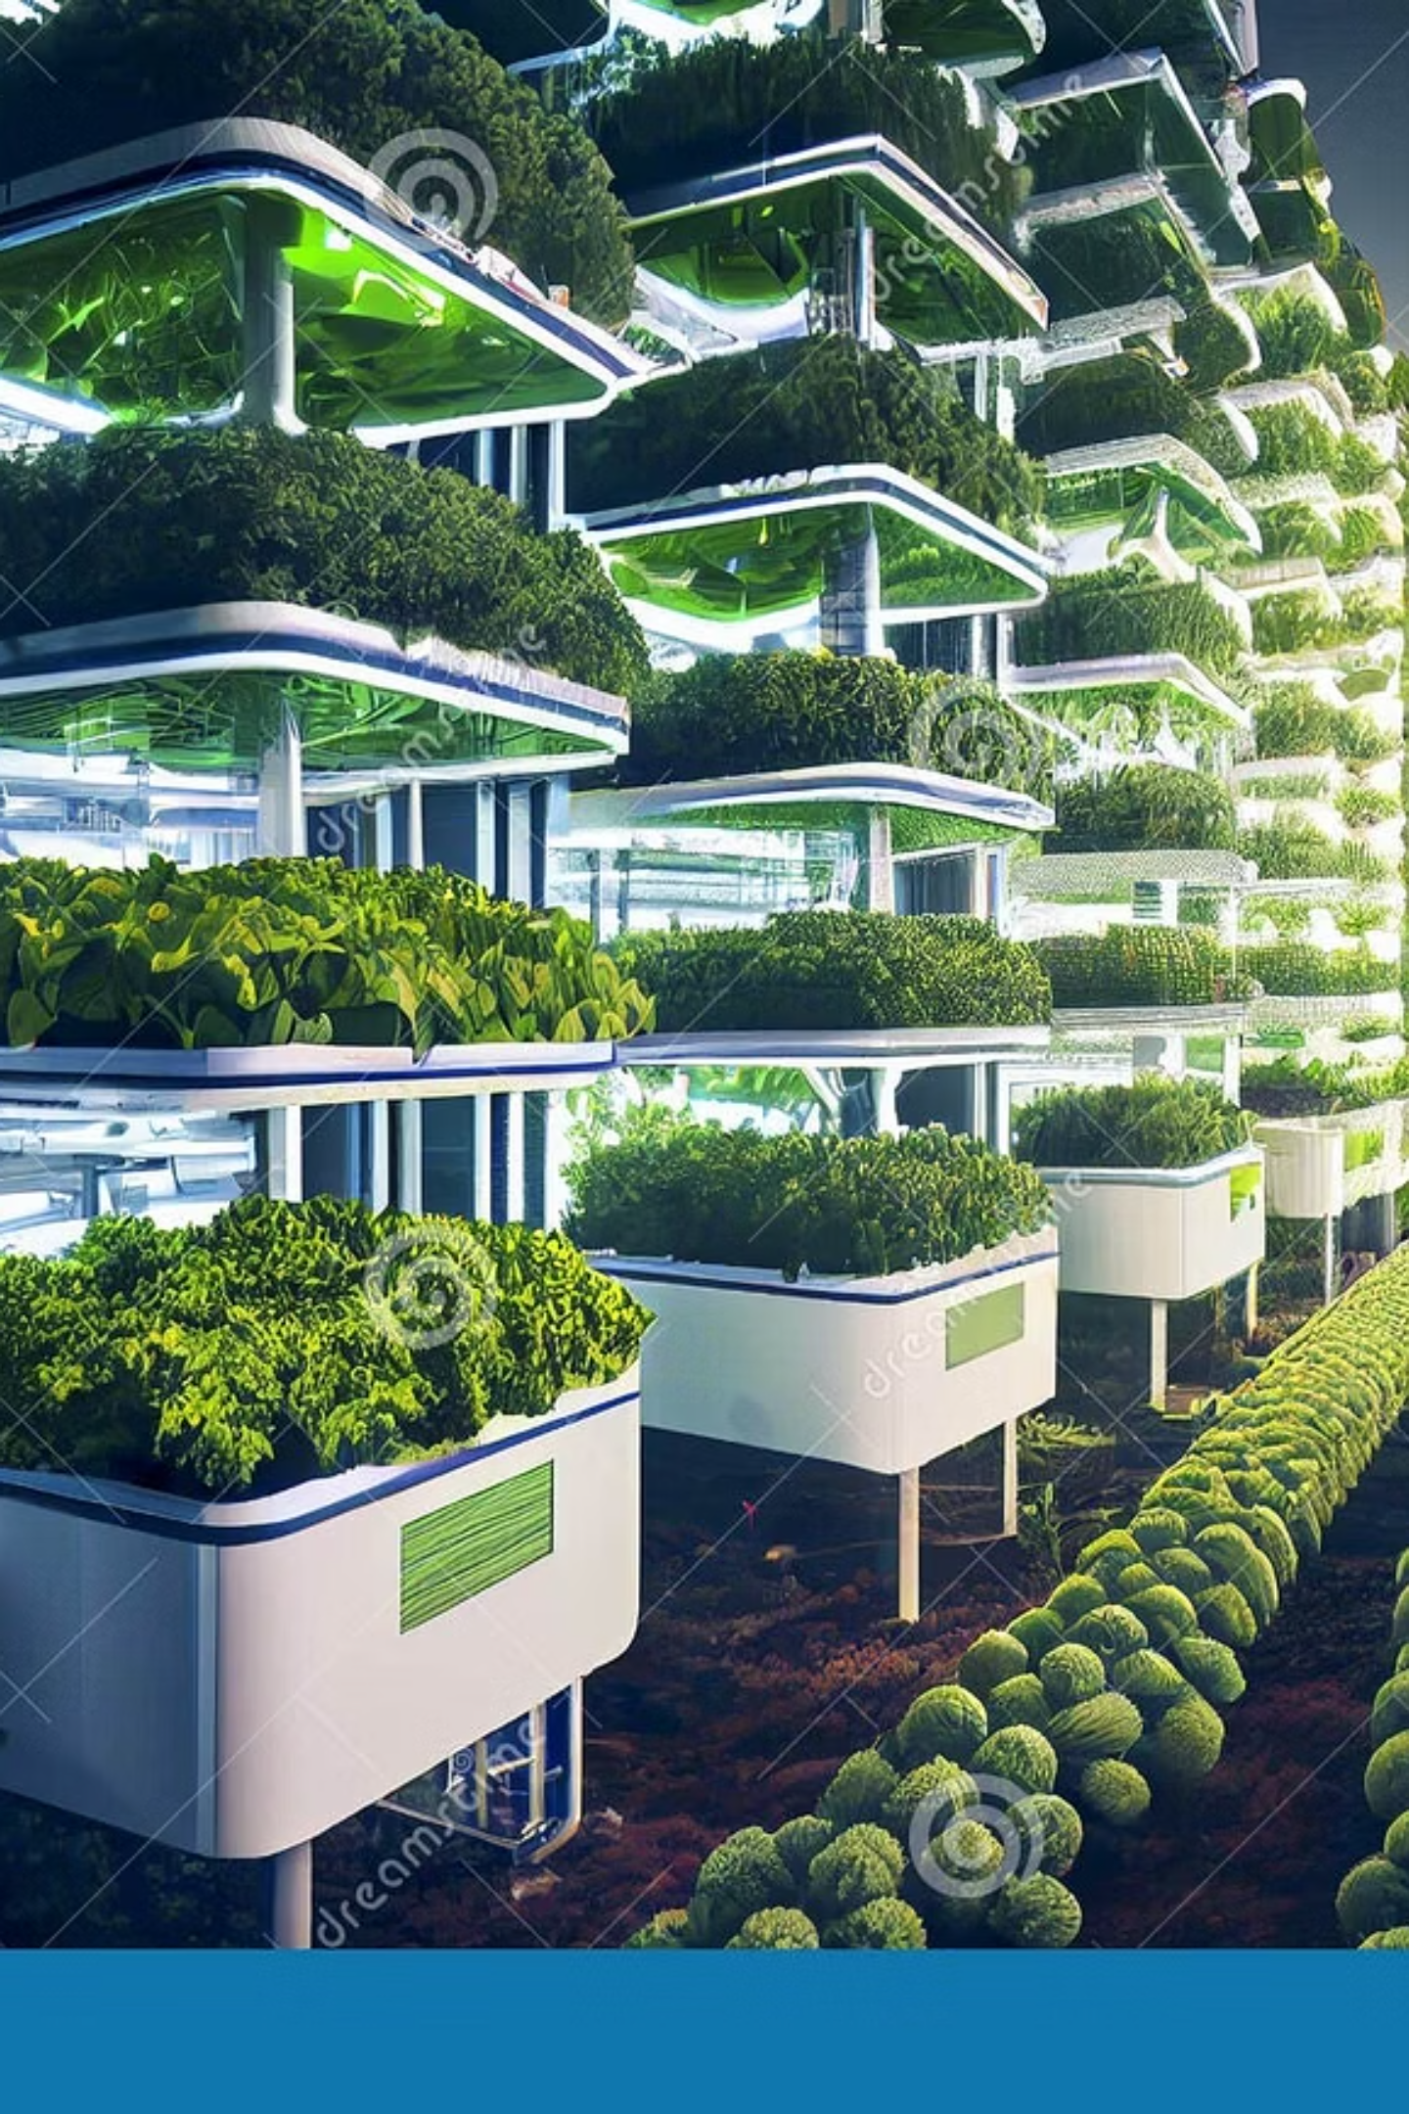
GreenSight-AI: Cultivating the Future of Agriculture
Welcome, investors and agricultural leaders! We are Group9, thrilled to present our groundbreaking project: GreenSight-AI.

Slide 2
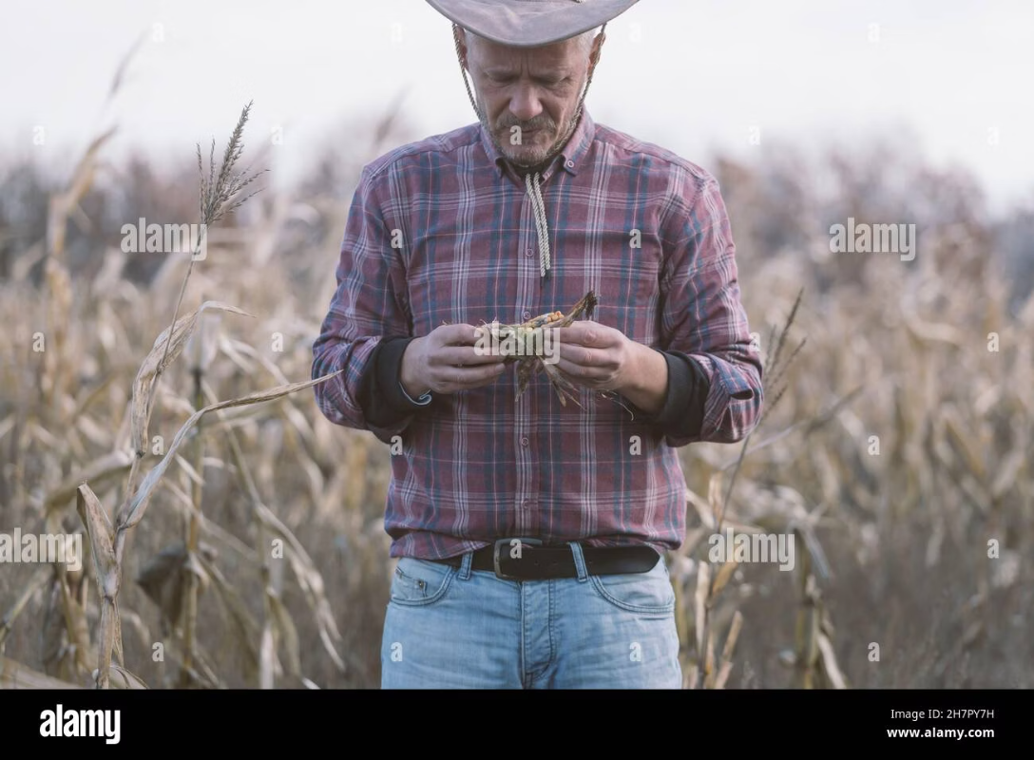
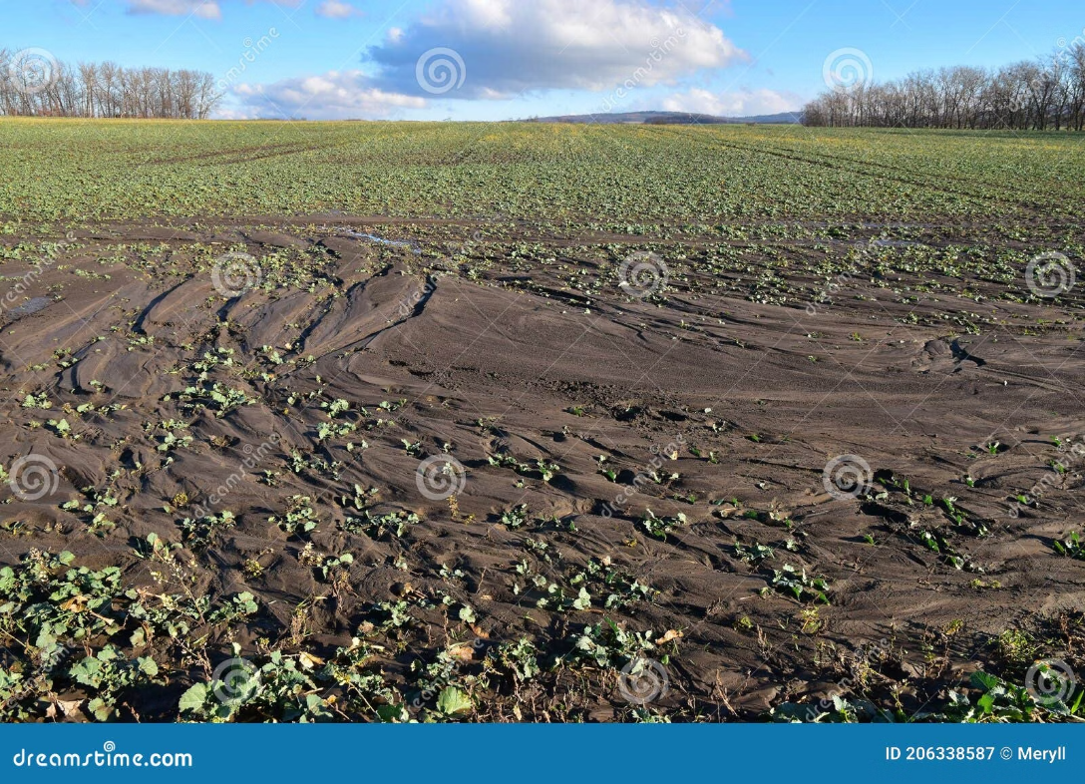
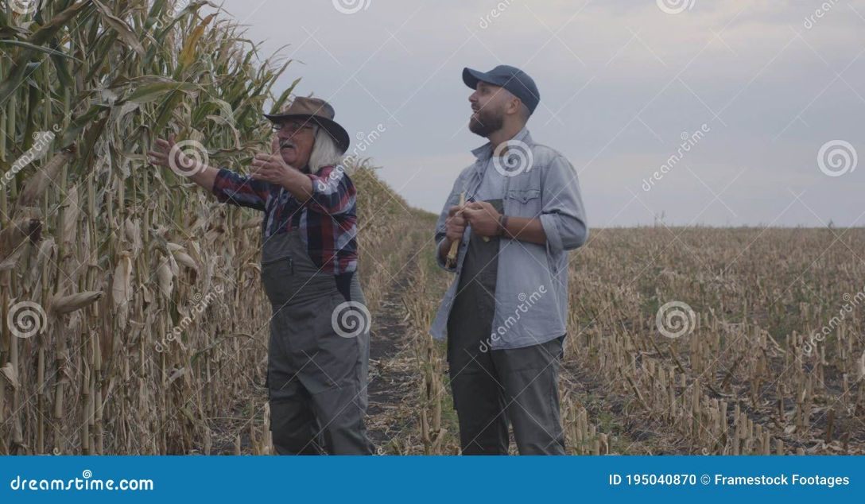

Addressing Core Challenges in Traditional Agriculture
Over-reliance on Personal Experience
Disease Identification Difficulties
Unrefined Management Practices
Knowledge transfer is inconsistent, and new farmers lack immediate access to expert agricultural guidance.
Farmers struggle with timely and accurate disease recognition, leading to delayed responses and significant crop losses.
Inefficient, labor-intensive methods often result in wasted resources and suboptimal yields.
These challenges directly impact crop yields, resource efficiency, and ultimately, farmers' profitability. GreenSight-AI is engineered to overcome these hurdles.

Slide 3



Introducing GreenSight-AI : Your Intelligent Farm Companion
Smart Disease Analysis
AI Agronomy Recommendations
Data-Driven Insights
Visualize farm data with intuitive dashboards, enabling users to understand growth trends and make informed decisions.
Utilize mobile photography for rapid and precise identification of plant diseases, offering instant diagnostic capabilities.
Beyond diagnosis, our platform provides tailored management solutions and preventative strategies for optimal crop health.
GreenSight-AI is an integrated, intelligent platform designed to revolutionize agricultural management.

Slide 4

The Evolution of GreenSight-AI : From Concept to Reality
02
03
V1.0: Early Demo Release
V2.0: Final Release & Full Functionality
Our first functional prototype, demonstrating basic disease identification and initial user interface. Watch the V1.0 demo video to see our initial vision!
The culmination of extensive development and feedback, offering a robust, user-friendly, and comprehensive solution.
Our iterative development journey has been instrumental in shaping GreenSight-AI into the powerful tool it is today.

Slide 5
插入视频

Slide 6
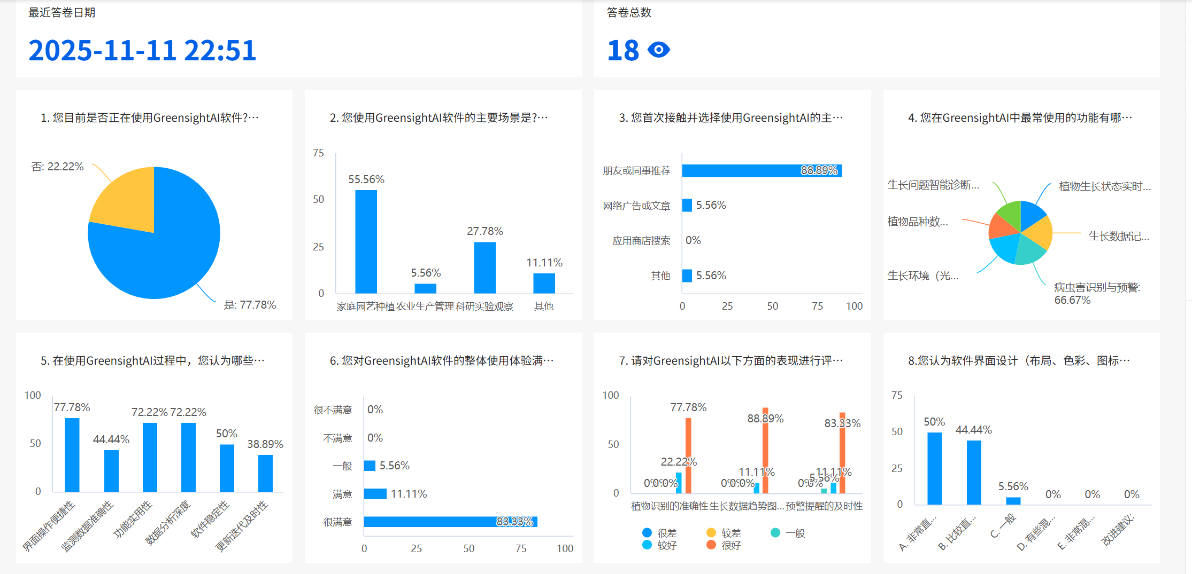
Insightful Guidance: Mentor Feedback
"The GreenSight-AI team has shown remarkable dedication in translating complex agricultural science into an accessible, impactful tool for farmers. Their responsiveness to feedback, especially regarding user experience and practical application, has been pivotal in shaping V2.0 into a truly valuable solution."
Valuable insights from our mentors have significantly refined our platform, ensuring it meets the real-world needs of farmers.

Slide 7
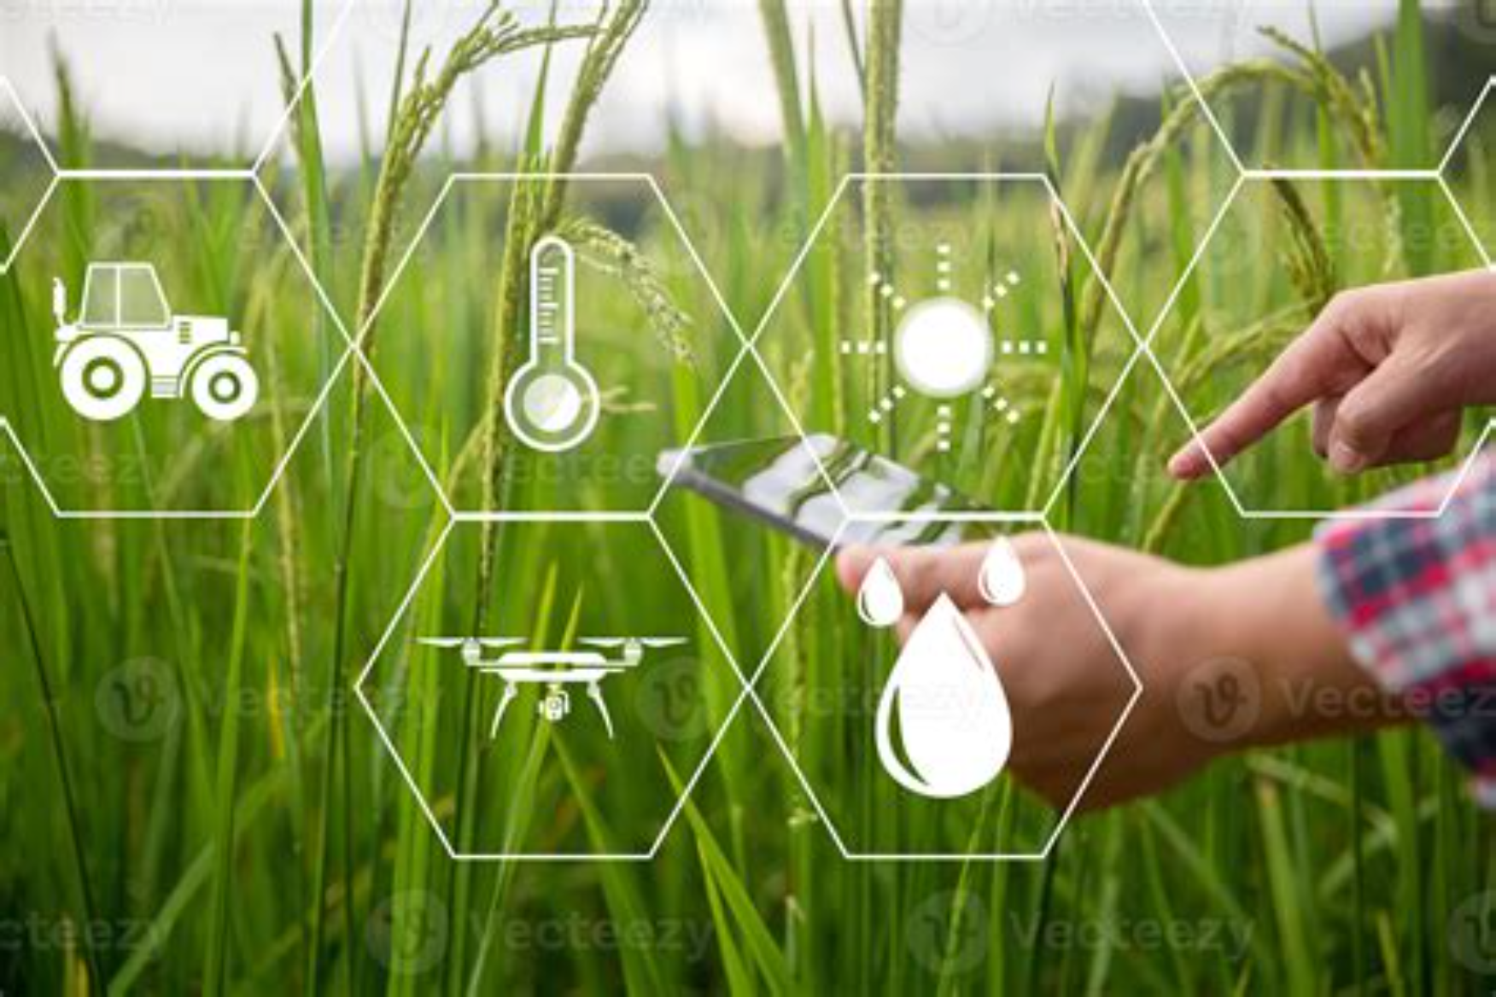
Experience the Leap: GreenSight-AI V2.0 Live Demo
Experience V2.0!
We invite you to click the link on the screen to personally experience the powerful features of GreenSight-AI V2.0.
Witness the enhanced smoothness and comprehensive functionality firsthand!
https://greensight-ai-ui-ux-li59.bolt.host

Slide 8

User-Centric Development: Feedback & Refinement
Through over 15 user tests, we transformed direct feedback into tangible improvements, ensuring V2.0 is both powerful and user-friendly.
V1.0 User Pain Points
V2.0 Solutions
We consulted our professional course professor and completed
the deployment under his guidance.
1.The visual model failed to be deployed successfully.
2. More attractive pictures were added to the loading interface
of the app, and the operation interface was optimized to make
it more concise.
2.The UI interface is not aestheticallypleasing.

Slide 9
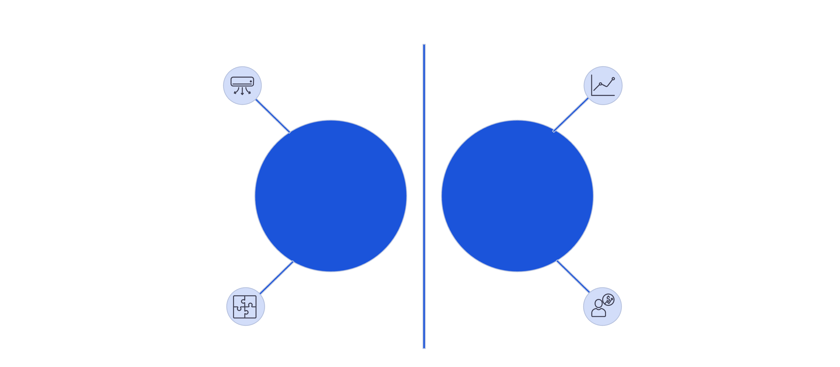
Market Landscape & Competitive Edge
Integrated AI Solutions
Data-Driven Decision Making
Agri‑Monitor
Competitors
Partial AI Support
Limited Analytics
Our in-depth competitive analysis reveals GreenSight-AI 's distinct advantages in feature integration and pricing strategy, setting us apart in the agritech market.

Slide 10
Key Strengths & Market Opportunities
Integrated AI Solution
Data-Driven Decision Making
Targeting Small & Medium Farmers
A unified platform for diagnosis, advice, and data, reducing the need for multiple disparate tools.
Empowering farmers with actionable insights derived from visualized farm data.
Filling a crucial gap by providing sophisticated tech accessible to a broader agricultural demographic.
The market demands consolidated solutions, technology accessible at the grassroots level, and the unlocking of data's potential – all areas where GreenSight-AI excels.

Slide 11
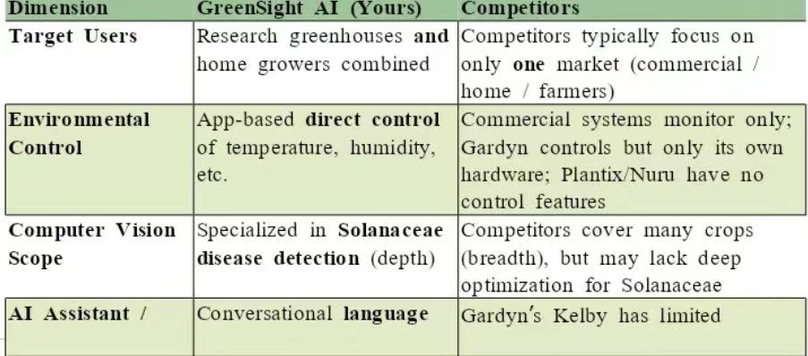
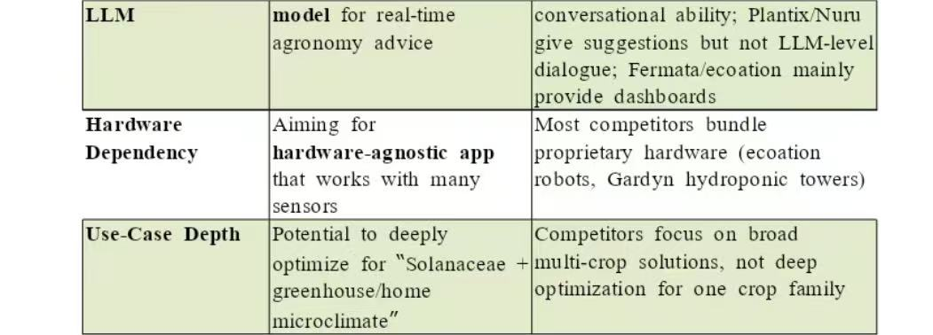
Market Landscape & Competitive Edge

Slide 12

Driving Adoption: Outreach & Impact
Targeted Promotion
Proven Market Acceptance
Our strategic focus on WeChat communities and university channels has proven highly effective.
Significant exposure in key agricultural and tech communities.
Engaging promotional materials designed for diverse audiences.
High click-through rates indicating strong initial interest.
Impressive user conversion rates validating product appeal.
Leveraging digital platforms for maximum reach.
The positive user response and successful outreach campaigns demonstrate strong market validation for GreenSight-AI.

Slide 13
Q&A
GreenSight AI project team
Thank you for your listening!

